Slide 1
Machines
14-2

Slide 2
Lesson Objectives
I can describe what a machine is.
I can describe how a machine makes work easier to do.
I can describe the relationship between force and distance when using a machine.

Slide 3

Work and Power Lab
So last time we saw that the amount of work you do depends on a force being used to move an object a certain distance. The faster you accomplish it, the more power there is!
So, if someone has to get themselves
up a certain distance, then they have to
do the equivalent amount of work
It doesn’t matter how fast you do it, as long as the force and
the distance remain the same, the work is the same as well!
The effort Homer needs to
jump up is the force!
The height of
this staircase
is the distance
The force of the jump x height of the stairs is the work homer accomplished!

Slide 4
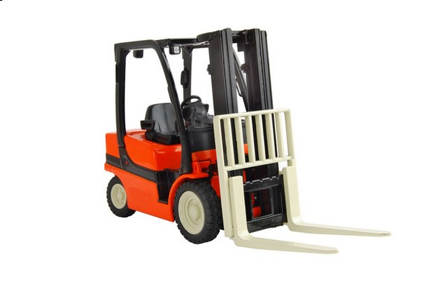


How does it apply to real life?
Or, they could use a machine of some kind that will do the same work but with less effort!
They can just pick it up themselves and lift it; but this could take lots of effort!
There are two ways to do it but the amount of work is still the same!
If someone needed to lift a box to the top of the pile…
?

Slide 5
Machines
A device that helps makes work easier by these 3 things:
Changing the size of the force
Changing the direction of the force
The distance over which the force acts
Note: They do not increase the amount of work done or
decrease the amount of work you do

Slide 6
Forces involved:
Input Force
  F_{e}
  Force applied to a machine
Output Force
  F_{r}
  Force applied by a machine

Slide 7
Two forces, thus two types of work
Work Input
work done on a machine and move it through a distance
=Input force x the distance through which that force acts (input distance)
Work Output
Work done by the machine through a distance
=Output force x the distance through which the resistance moves (output distance)

Slide 8
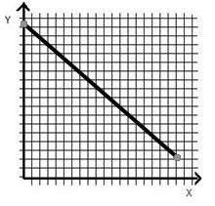
Relationship between force and distance
As 1 increase the other 1 decreases.
Ex. If the force is increased the distance will decrease.
Inversely Related
Negative trend/negative correlation

Slide 9
Can you get more work out than you put in?
Big Idea
Work output can never be greater than work input because of friction

Slide 10
How can you increase the work output of a machine?
Increase the work input or decrease the friction.

Slide 11
Big Ideas
1) Machines make work easier by these 3 things:
Changing the size of the force
Changing the direction of the force
The distance over which the force acts
2) They do not increase the amount of work done or decrease the amount of work you do.

Slide 12
Big Ideas
3) The relationship between force and distance is as one increases the one decreases.
Inversely Related
Negative trend/negative correlation on graph
4) Work output is never greater than work input because of friction.

